Slide 1
OO Programming Concepts
Python supports both Procedural and Object Oriented approaches in problem solving.
user can solve the complex problems with procedural approach but it makes difficulty in organizing and readability of the code.
By using object oriented approach we can better organize the code and readability.
Object-oriented programming (OOP) involves programming using an objects.
An object represents an entity in the real world that can be distinctly identified.
For example:
a student, a desk, a circle, a button, and even a loan can all be viewed as objects.
An object has a unique identity, state, and behaviors.
The state of an object consists of a set of data fields (also known as properties) with their current values.
The behavior of an object is defined by a set of methods.

Slide 2
OOPS CONCEPTS
Class | Class is a user-defined prototype for an object that defines a set of attributes that characterize any object of the class.
Object | A unique instance of a data structure that's defined by its class. An object comprises both data members (class variables and instance variables) and methods.
Encapsulation | In an object oriented python program, you can restrict access to methods and variables. This can prevent the data from being modified by accident and is known as encapsulation
Inheritance | A new class derived from base class is known as inheritance, here one object acquires all the properties and behaviors of parent object
Polymorphism | Sometimes an object comes in many types or forms. If we have a button, there are many different draw outputs (round button, check button, square button, button with image) but they do share the same logic: onClick(). We access them using the same method . This idea is called Polymorphism.
Abstraction | Its main goal is to handle complexity by hiding unnecessary details from the user.
Association | In object-oriented programming, association defines a relationship between classes of objects that allows one object instance to cause another to perform an action on its behalf.

Slide 3
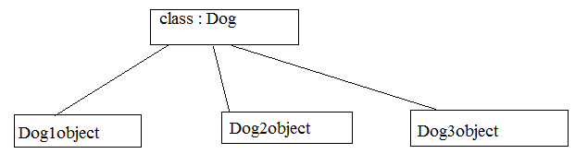
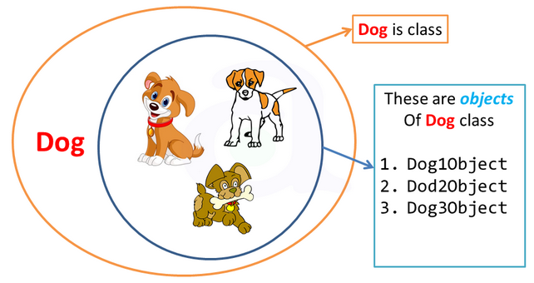
What is the difference between Object & class?
A class is a blueprint or prototype that defines the variables and the methods (functions) common to all objects of a certain kind.
An object is an instance of a class. Software objects are often used to model real-world objects you find in everyday life.

Slide 4
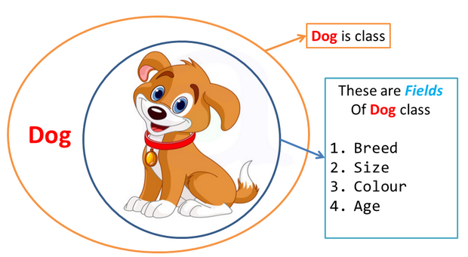
Class Attributes
"In computing, an attribute is a specification that defines a property of an object, element, or file. It may also refer to or set the specific value for a given instance of such."

Slide 5
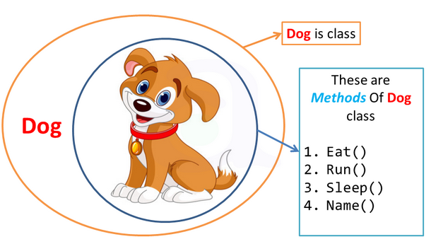
Method
Methods in Python are essentially functions in accordance with Guido's saying "first-class everything".

Slide 6
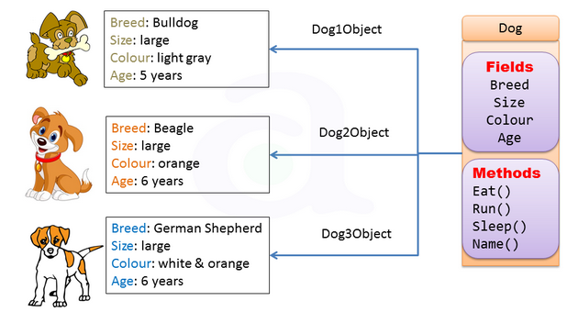
concept of class, Object and methods
Class - Dogs
Data members / Attributes - breed, size, color, age etc.
Methods- eat(), run(), sleep(), name().
Objects – Dog1Object, Dog2Object, Dog3Object

Slide 7
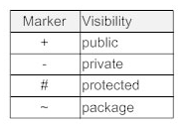
Uml Diagram In an object oriented python program, you can restrict access to methods and variables by using the following symbols before attributes and methods as shown below
dog
+Breed +size +colour -Age
+Eat() +Run() +Sleep() +Name()

Slide 8
Class Declaration in code
A class is a special data type which defines how to build a certain kind of object
The attributes are data members (class variables and instance variables) and methods, accessed via dot notation.
Syntax:
class ClassName:
<statement-1>
.
.
<statement-N>
Example
class Dog: pass

Slide 9
Object creation in code:
Syntax:
ObjectName=className()
Obj=Myclass()
Example 1:
Dog1Object = Dog()
print(Dog1Object)
Here Dog1Object is an object (or instance) of the class Dog.

Slide 10

class dog: class
Breed='Bulldog'
size='Large'
colour='Light gray‘ Attributes
__Age=5
def Eat(self):
print("pedigree")
def Run(self): Methods
print("fast")
def Sleep(self):
print("6 hr a day") Object Creation
def Name(Self):
print("jack")
Dog1Object=dog()
print(Dog1Object.Breed)
Dog1Object.Run()
dog
+Breed +size +colour - Age
+Eat() +Run() +Sleep() +Name()
Dog1object
Bulldog Large Light gray 5
Eat() Run() Sleep() Name()

Slide 11
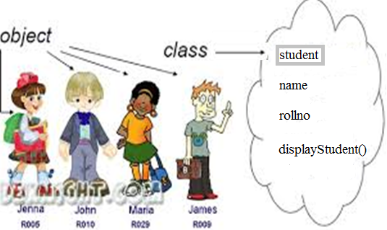
Constructors in Python
Class functions that begins with double underscore (__) are called special functions as they have special meaning.
__init__ is a method which is immediately and automatically called after an instance has been created for a class
The __init__ method is used to initialize an instance.
The __init__ method can be anywhere in a class definition, but it is usually the first method of a class, i.e. it follows right after the class header.
Example
class Student:
def __init__(self):
print("__init__ has been executed!")
stud_1=Student( )
#__init__ has been executed!

Slide 12
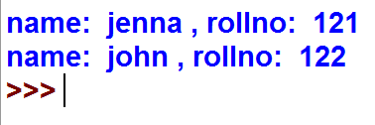
constructor Example :
class Student:
def __init__(self, name,rollno): # automatically executed
self.name = name when obj created
self.rollno = rollno
def displayStudent(self):
print ("name: ", self.name, ", rollno: ", self.rollno )
Stud_1 = Student( “jenna“,121) # values passed while initializing object
Stud_2= Student(“john“,122)
Stud_1.displayStudent()
Stud_2.displayStudent()
Student
+name +rollNo
+displayStudent( )
Stud_1
Jenna 121
display Student()
Stud_2
John 122
display Student()

Slide 13
Destructor
These methods are only called on creation and destruction of the object. They are not called manually but completely automatic.
Example
The class below has a constructor (init) and destructor (del).We create an instance from the class and delete it right after.
class Student:
def __init__(self):
print()
def __del__(self):
print('Destructor called, vehicle deleted.')
Stud_1=Student()
del Stud_1 # stud_1 gets deleted

Slide 14
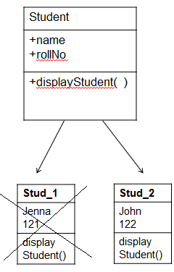
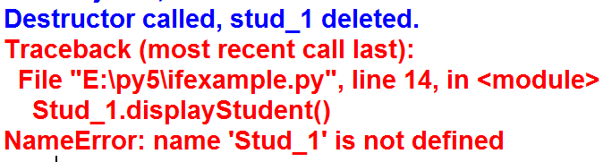
destructor Example :
class Student:
def __init__(self, name,rollno): self.name = name
self.rollno = rollno
def displayStudent(self):
print ("name: ", self.name, ", rollno: ", self.rollno )
def __del__(self): # automatically destructed
print('Destructor called, stud_1 deleted.')
Stud_1 = Student( "jenna",121) # values passed while initializing object
Stud_2= Student("john",122)
Stud_1.displayStudent()
Stud_2.displayStudent()
del Stud_1
Stud_1.displayStudent()

Slide 15
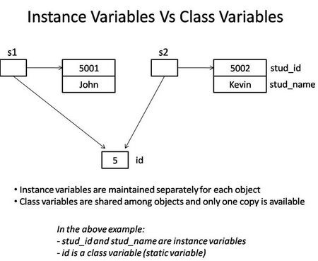
Class variable Vs Object variable.
Class variable :-
class variable is shared and accessed by all objects of class.
When any one object makes a change to class variable, the change is reflected in all instances.
Object Variable :-
Owned by individual object/instance
Each object has its own copy not Shared

Slide 16
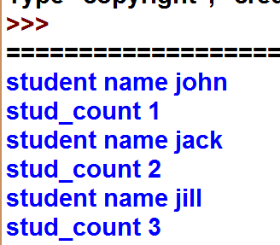
Class variable Vs Object variable Example :
class Student:
count=0
name=" "
def __init__(self,name):
Student.count+=1 #Class variable
self.name=name #Object variable
print("student name",name)
print("stud_count",Student.count)
stud1=Student("john")
stud2=Student("jack")
stud3=Student("jill")
print(Student.name)

Slide 17
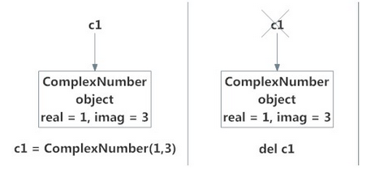

Deleting Attributes and Objects
similar to destructor.
automatically called when object is going out of scope
To delete an attributname:
Syntax: del objname.attributename
To delete an object:
Syntax : del objectname
Example:
class ComplexNumber:
def __init__(self,r = 0,i = 0):
self.real = r
self.imag = i
def getData(self):
print("{0}+{1}j".format(self.real,self.imag))
c1 = ComplexNumber(2,3)
c1 = ComplexNumber(1,3)
del c1
c1

Slide 18
Methods ….
Let’s begin by writing a class that contains simple examples for all three method types:
Instance Methods
The first method on MyClass, called method, is a regular instance method.
You can see the method takes one parameter, self, which points to an instance of MyClass when the method is called
Class Methods
Instead of accepting a self parameter, class methods take a cls parameter that points to the class—and not the object instance—when the method is called.
Static Methods
This type of method takes neither a self nor a cls parameter
def method(self): return 'instance method called', self
@classmethod def classmethod(cls): return 'class method called', cls
@staticmethod def staticmethod(): return 'static method called'

Slide 19
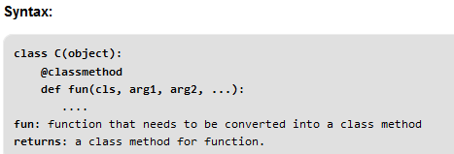
Methods ….
Class Method
A class method is a method which is bound to the class and not the object of the class.
They have the access to the state of the class as it takes a class parameter that points to the class and not the object instance.
It can modify a class state that would apply across all the instances of the class. For example it can modify a class variable that will be applicable to all the instances.

Slide 20
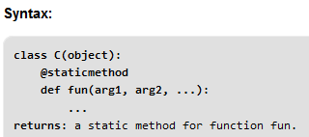
Methods ….
Static Method
A static method is also a method which is bound to the class and not the object of the class.
A static method can’t access or modify class state.
It is present in a class because it makes sense for the method to be present in class.
When to use what?
We generally use class method to create factory methods. Factory methods return class object ( similar to a constructor ) for different use cases.
We generally use static methods to create utility functions.

Slide 21

Example
from datetime import date
class Person:
def __init__(self, name, age): #instance method
self.name = name
self.age = age
@classmethod # a class method to create a Person object by birth year.
def fromBirthYear(cls, name, year):
return cls(name, date.today().year - year)
@staticmethod # a static method to check if a Person is adult or not.
def isAdult(age):
return age > 18
person1 = Person('mayank', 21)
print person1.age
print Person.isAdult(22)
person
+Name +age
+fromBirthYear( ) +isAdult ( )
person1
mayank 21
fromBirthYear( ) isAdult ( )

Slide 22
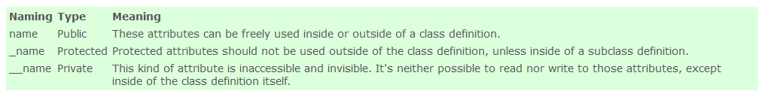
Encapsulation
In an object oriented python program, you can restrict access to methods and variables. This can prevent the data from being modified by accident and is known as encapsulation.
It allows programmers better control of how data flows in their programs, and it protects that data
Access Modifiers in python
Access Modifiers | UML Diagram | In Python
Public | + Var_name | Varname /method
Private | - name | _Varname / method
Protected | # name | __Varname /method

Slide 23

Encapsulation cont….
Private variables
A private variable can only be changed within a class method and not outside of the class.
Example
class Car:
__maxspeed = 0 Private Variable
__name = ""
def __init__(self):
self.__maxspeed = 200
self.__name = "Supercar"
def drive(self): Public Method
print ('driving. maxspeed ' + str(self.__maxspeed))
redcar = Car()
redcar.drive()
redcar.__maxspeed = 10 # will not change variable because its private
redcar.drive()
car
- name : string - Maxspeed : int
+ drive()

Slide 24
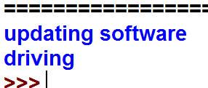
Encapsulation cont….
Private methods
We create a class Car which has two methods: drive() and updateSoftware(). When a car object is created, it will call the private methods __updateSoftware().
This function cannot be called on the object directly, only from within the class.
Example
class Car:
def __init__(self):
self.__updateSoftware()
def drive(self):
print (‘ driving' ) Public Method
def __updateSoftware(self): Private Method
print ('updating software' )
redcar = Car()
redcar.drive()
car
+ drive () - updateSofware()

Slide 25
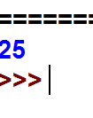
Encapsulation cont….
Protected
A variable that is protected can only be accessed by its own class and any classes derived from it.
Example
class Person:
def __init__(self, first_name, age):
self.first_name = first_name
self._age = age
def _show_age(self):
return self._age
tk = Person('TK', 25)
print(tk._show_age( ))
Person
+ first_name # age
# show_age()

Slide 26
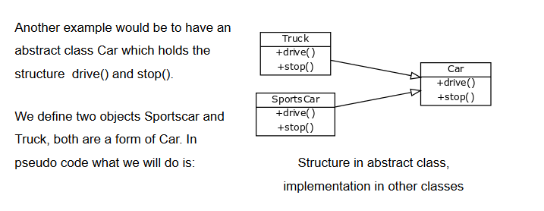
Polymorphism
Sometimes an object comes in many types or forms. If we have a button, there are many different draw outputs (round button, check button, square button, button with image) but they do share the same logic: onClick(). We access them using the same method . This idea is called Polymorphism.
The polymorphism supports for following concepts
Operator overloading
Method overloading
Method overridding

Slide 27

Method Overriding
Override means having two methods with the same name but doing different tasks. It means that one of the methods overrides the other.If there is any method in the superclass and a method with the same name in a subclass, then by executing the method, the method of the corresponding class will be executed.
class Rectangle():
def __init__(self,length,breadth):
self.length = length
self.breadth = breadth
def getArea(self):
print(self.length*self.breadth," is area of rectangle")
class Square(Rectangle):
def __init__(self,side):
self.side = side Method Override
Rectangle.__init__(self,side,side)
def getArea(self):
print(self.side*self.side*self.side," is area of square")
s=Square(4)
s.getArea()
Rectangle
+length +breadth
+getArea()
Square
+side
+getArea()

Slide 28
Method overloading
In Python you can define a method in such a way that there are multiple ways to call it.
Depending on the function definition, it can be called with zero, one, two or more parameters.
Example:
class Human:
def sayHello(self, name=None):
if name is not None:
print ('Hello ' + name)
else:
print('Hello ' )
obj = Human()
obj.sayHello() Method overloaded
obj.sayHello('Guido')
Output:
Hello
Hello Guido
+sayHello()
+sayHello(‘Guido’)
Obj

Slide 29
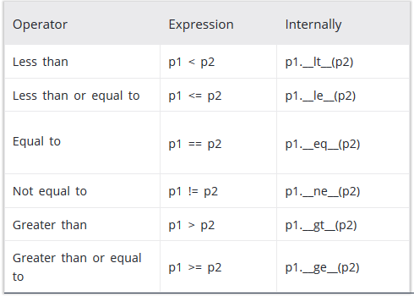
Operator Overloading
Python operator work for built-in classes. But same operator behaves differently with different types. For example, the + operator will, perform arithmetic addition on two numbers, merge two lists and concatenate two strings.
This feature in Python, that allows same operator to have different meaning according to the context is called operator overloading.
Operator Overloading Special Functions in Python

Slide 30
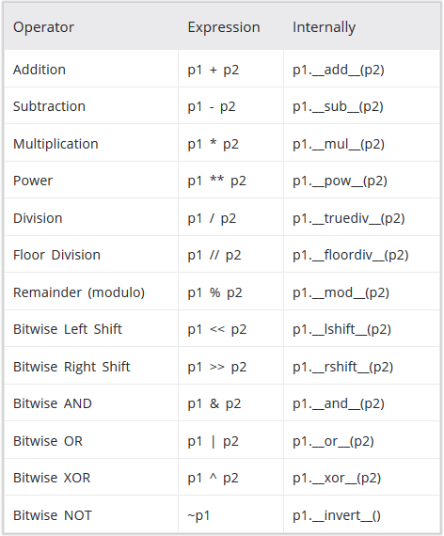
Operator Overloading cont…

Slide 31
Overloading the + Operator in Python To overload the + sign, we will need to implement __add__() function in the class.
class Point:
def __init__(self, var_x = 0, var_y = 0):
self.var_x = var_x
self.var_y = var_y
def __str__(self):
return "({0},{1})".format(self.x,self.y)
def __add__(self,other):
x = self.x + other.x
y = self.y + other.y
return Point(x,y)
p1 = Point(2,3)
p2 = Point(-1,2)
print(p1 + p2)
Point
+ var_x + var_y
__str__() __add__()
Output
(1,5)
when user do p1 + p2, Python will call p1.__add__(p2) which in turn is Point.__add__(p1,p2).
Similarly, user can overload other operators as well using the special functions.

Slide 32
Object Serialization with Pickle
Objects can be serialized: stored in a format for later use. Once an object is serialized, it can be stored in a file and loaded from a file. The pickle module can be used for object serialization.
Create and dump an object
We start by creating a class and object. Then we use the module dumps() with as parameter the object.
import pickle class A: def __init__(self): self.name = 'A' self.type = 'class' obj = A() dump = pickle.dumps(obj) print(dump)

Slide 33
Store and load object from file More practical is to store the serialized object in file. Then we can reload it from that file at any time. To store a serialized object into a file:
import pickle
class A:
def __init__(self):
self.name = 'A'
self.type = 'class'
obj = A()
print(obj.name)
print(obj.type)
bin_file = open('dump.bin',mode='wb')
dump = pickle.dump(obj, bin_file)
bin_file.close()
Then the object can be loaded from the file. This can be done at any time or even from another program.
import pickle
class A:
def __init__(self):
self.name = 'A'
self.type = 'class'
with open('dump.bin') as f:
obj = pickle.load(f)
print(obj.name)
print(obj.type)

